Slide 1
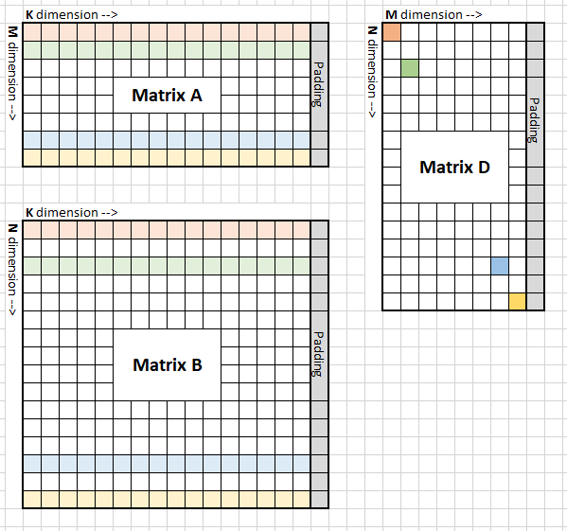
Auto generator
Example :
Data type: bf16
Gemm format: column major
Gemm size: M = 960, N = 1024, K = 1024
Padding: 32DWORD
Mfma per wave: 1 * 2
Wave per group: 2 * 2
MT size: 64 * 128

Slide 2
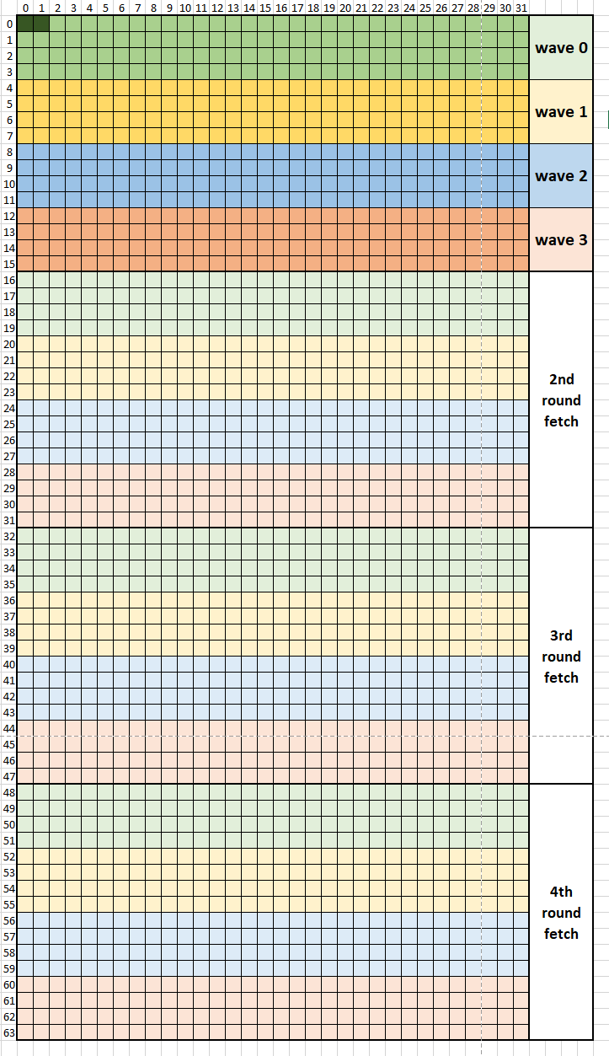
Auto generator
Global fetch work load:
Fetcht instruction width:
1DWORD = 2 element
Fetch amount:
A: DepthU * MT0 = 32 * 64 elements
B: DepthU * MT1 = 32 * 128 elements
Fetch amount per wave:
DepthU * 4 = 32 * 4 elements
Fetch amount per round:
DepthU * 4 * wave_num = 32 * 16 elements
Fetch rounds:
A: MT0 / (4* wave_num) = 4
B: MT1 / (4* wave_num) = 8

Slide 3
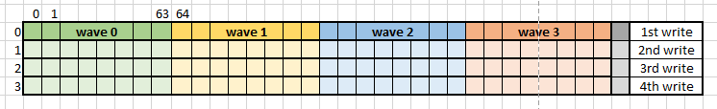
Auto generator
LDS storage :
Lds buffer size:
A: depthU * MT0 * ele_sz = 32 * 64 * 2 = 4KB
B: depthU * MT1 * ele_sz = 32 * 128 * 2 = 8KB
Total LDS size = (A+B) * 2 = 32KB
Lds write instruction size: 2 elements = 4Byte
Lds write per round: 32 * 16 elements = 1KB
Lds write rounds: 4 rounds for A; 8 round for B

Slide 4
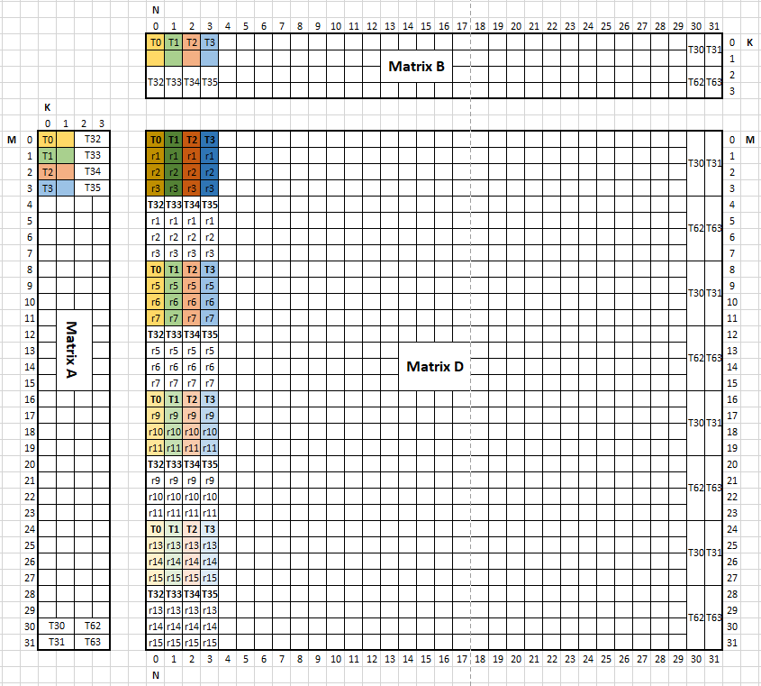
Auto generator
mfma:
Matrix A
M * K = 31 * 4
Every thread hold 2 elements in K dim
Matrix B
N * K = 31 * 4
Every thread hold 2 elements in Kdim
Matrix D
M * N = 31 * 31
Every thread hold 4 lane in M dim
Every lane has 4 elements in M dim
One lane of store
One tile for store

Slide 5
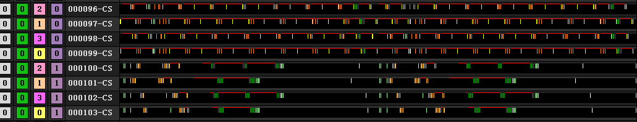
Auto generator
2 wave iteration
Fetch finish
Math finish
barrier
Thread trace for 2 buffers

Slide 6
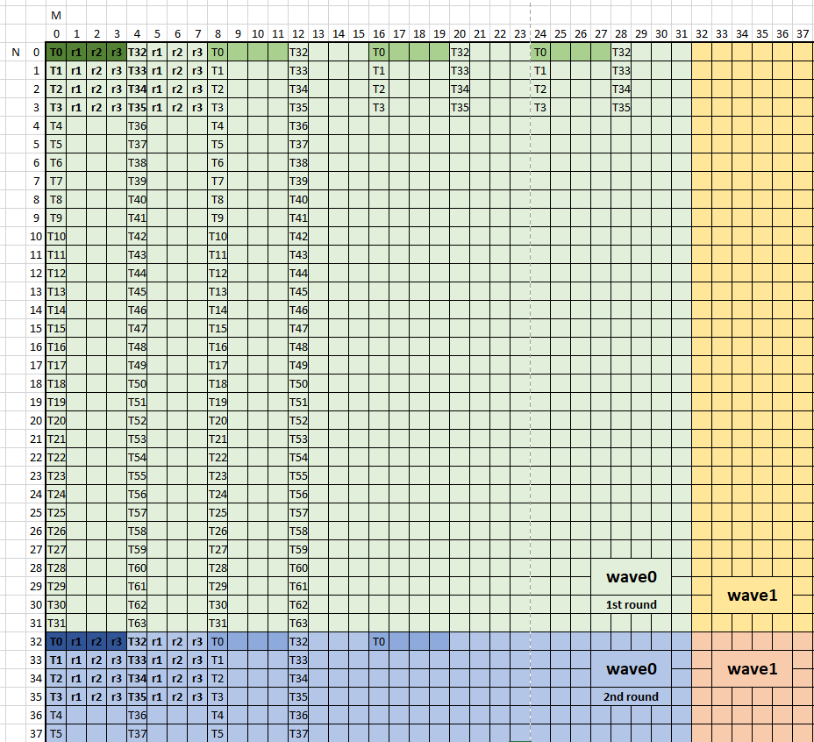
Auto generator
Global store work load:
store instruction width:
1DWORD = 2 element
store amount:
mfma_tile * mfma_tile * round
= 4 * 4 * 2 = 32 elements / thread
Store round:
mfma per wave = 2 round
One tile for store
One lane of store

Slide 7
Auto generator
Usage:
Example: ./TensileLite.out –m 1024 –n 1024 –k 1024 –t 0 –v 1 –l 100 –r 1 –s 2 –x 2 –y 2 –d 1
-m: gemm size in M without padding, default is 1024
-n: gemm size in N without padding, default is 1024
-k: gemm size in K without padding, default is 1024
-d: data type. 1=fp32, 2=fp16, 3=bf16. default is 1
-v: if enable cpu verification. 1=enable, 0=disable. Default is 1
-l: iteration times to measure kernel performance
-t: enable tensile portable kernel name. 1=using tensile format, 0 = using local format

Slide 8
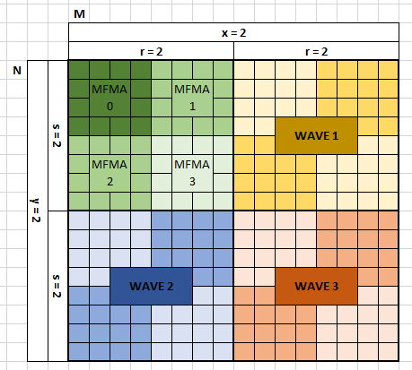
Auto generator
Usage continue:
Example: ./TensileLite.out –m 1024 –n 1024 –k 1024 –t 0 –v 1 –l 100 –r 2 –s 2 –x 2 –y 2 –d 1
-r: mfma tile per wave in M dim, default is 1
-s: mfma tile per wave in N dim, default is 1
-x: wave tile per group in M dim, default is 1
-y: wave tile per group in N dim, default is 1
-u: depthU in K dim, default is 16

Slide 9
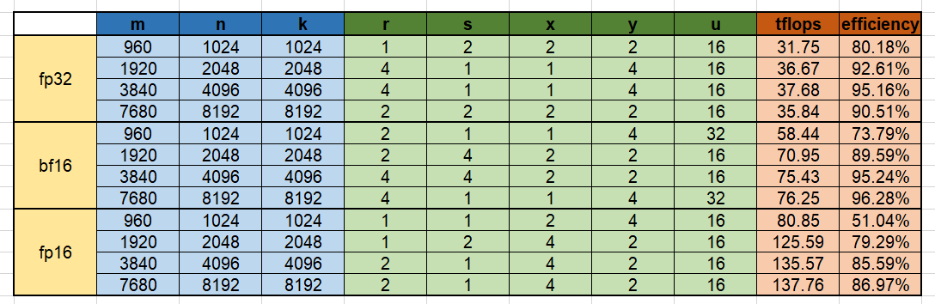
Auto generator
Performance – 1K/2K/4K/8K:

Slide 10
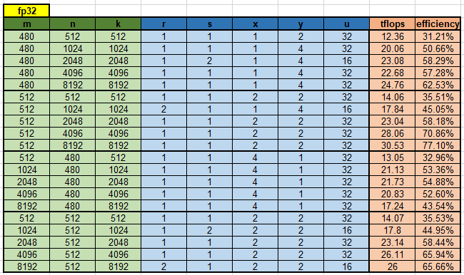
Auto generator
Performance – Phantom fp32:

Slide 11
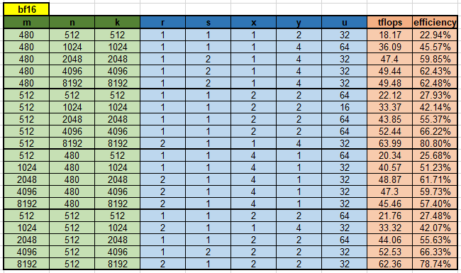
Auto generator
Performance – Phantom bf16:

Slide 12
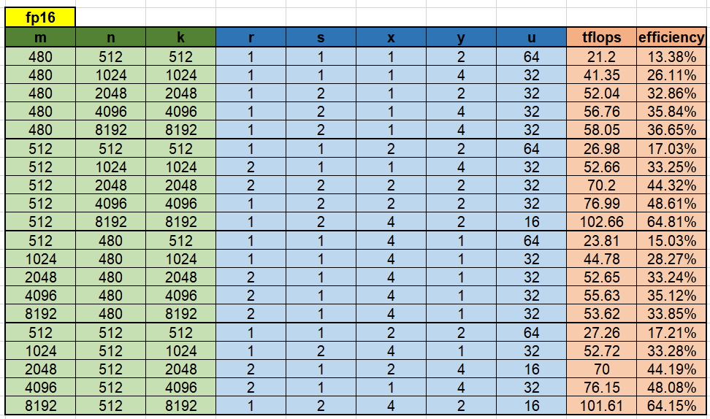
Auto generator
Performance – Phantom fp16:

Slide 13
Auto generator
KERNEL WRITER FLOW:
Load size pre calcu
Check param
Calculate workgroup
checkKernelParameters()
Load kernel args
Calculate waveid/threadid
writeProgramDetail()
Separate math wave& fetch wave
write_double_wave_program()
Calcu A global fetch add
Calcu A LDS write addr
Calcu B global fetch add
Calcu B LDS write addr
Init accVgpr to 0
Calcu A LDS read addr
Calcu B LDS read addr
Calcu D global store addr
write_math_wave_program()
write_fetch_wave_program()
Buffer load A MT to LDS
Buffer load B MT to LDS
Switch LDS double buffer
Move to next fetch addr
fetch_glb_to_lds_loop()
barrier
Read A LDS mfma tile buff0
Read B LDS mfma tile buff0
Read A LDS mfma tile buff1
Read B LDS mfma tile buff1
Math mfma tile buff0
Read A LDS mfma tile buff0
Read B LDS mfma tile buff0
Math mfma tile buff1
…… ……
s_waitcnt
s_waitcnt
math_lds_loop()
barrier
Buffer load A MT to LDS
Buffer load B MT to LDS
Switch LDS double buffer
Move to next fetch addr
fetch_glb_to_lds_loop()
barrier
Read A LDS mfma tile buff0
Read B LDS mfma tile buff0
Read A LDS mfma tile buff1
Read B LDS mfma tile buff1
Math mfma tile buff0
Read A LDS mfma tile buff0
Read B LDS mfma tile buff0
Math mfma tile buff1
…… ……
s_waitcnt
s_waitcnt
math_lds_loop()
Read accVgpr
Data format
Store to matrix D addr
store_result()
Free gprs()

